Slide 1
Software Testing and Quality Assurance
Theory and Practice
Chapter 7
System Integration Testing
Notes:
Handouts
------------------------------------------------------------------
------------------------------------------------------------------
-------------------------------------------------------------------
--------------------------------------------------------------------

Slide 2
Outline of the Chapter
The Concept of Integration Testing
Different Types of Interfaces
Different Types of Interface Errors
Granularity of System Integration Testing
System Integration Techniques: Incremental, Top-down, Bottom-up, and Sandwich and Big-bang
Notes:
Handouts

Slide 3
The Concept of Integration Testing
A software module is a self-contained element of a system
Modules are individually tested commonly known as unit testing
Next major task is to put the modules, i.e., pieces together to construct the complete system
Construction of a working system from the pieces is not a straightforward task because of numerous interface errors
The objective of system integration testing (SIT) is to build a “working” version of the system
  Putting modules together in an incremental manner
  Ensuring that the additional modules work as expected without disturbing the functionalities of the modules already put together
Integration testing is said to be complete when
  The system is fully integrated together
  All the test cases have been executed
  All the severe and moderated defects found have been fixed
Notes:
Handouts

Slide 4
The Concept of Integration Testing
The major advantages of conducting SIT are as follows:
Defects are detected early
It is easier to fix defects detected earlier
We get earlier feedback on the health and acceptability of the individual modules and on the overall system
Scheduling of defect fixes is flexible, and it can overlap with development.
Notes:
Handouts

Slide 5
Different Types of Interfaces
Three common paradigms for interfacing modules:
Procedure call interface
Shared memory interface
Message passing interface
  The problem arises when we “put modules together” because of interface errors
Interface errors
  Interface errors are those that are associated with structures existing outside the local environment of a module, but which the module uses
Notes:
Handouts

Slide 6
Different Types of Interface Errors
Construction
Inadequate functionality
Location of functionality
Changes in functionality
Added functionality
Misuse of interface
Misunderstanding of interface
Data structure alteration
Inadequate error processing
Additions to error processing
Inadequate post-processing
Inadequate interface support
Initialization/value errors
Validation od data constraints
Timing/performance problems
Coordination changes
Hardware/software interfaces
Notes:
Handouts

Slide 7
Construction:
Some programming languages, such as C, generally separate the interface specification from the implementation code. In a C program, programmers can write a statement #include header.h, where header.h contains an interface specification. Since the interface specification lies somewhere away from the actual code, programmers overlook the interface specification while writing code. Therefore, inappropriate use of #include statements cause construction errors.

Slide 8
Inadequate Functionality
These are errors caused by implicit assumptions in one part of a system that another part of the system would perform a function. However, in reality, the “other part” does not provide the expected functionality—intentionally or unintentionally by the programmer who coded the other part.

Slide 9
Location of Functionality
Disagreement on or misunderstanding about the location of a functional capability within the software leads to this sort of error. The problem arises due to the design methodology, since these disputes should not occur at the code level. It is also possible that inexperienced personnel contribute to the problem.

Slide 10
Changes in Functionality:
Changing one module without correctly adjusting for that change in other related modules affects the functionality of
the program.

Slide 11
Added Functionality:
A completely new functional module, or capability, was added as a system modification. Any added functionality after the module is checked in to the version control system without a CR is considered to be an error..

Slide 12
Misuse of Interface:
One module makes an error in using the interface of a called module. This is likely to occur in a procedure–call interface. Interface misuse can take the form of wrong parameter type, wrong parameter order, or wrong number of parameters passed.

Slide 13
Misunderstanding of Interface:
A calling module may misunderstand the interface specification of a called module. The called module may assume that some parameters passed to it satisfy a certain condition, whereas the caller does not ensure that the condition holds.
For example, assume that a called module is expected to return the index of an element in an array of integers. The called module may choose to implement binary search with an assumption that the calling module gives it a sorted array. If the caller fails to sort the array before invoking the second module, we will have an instance of interface misunderstanding.

Slide 14
Data Structure Alteration:
These are similar in nature to the functionality problems discussed above, but they are likely to occur at the detailed design level. The problem arises when the size of a data structure is inadequate or it fails to contain a sufficient number of information fields. The problem has its genesis in the failure of the high-level design to fully specify the capability requirements of the data structure.
Let us consider an example in which a module reads the data and keeps it in a record structure. Each record holds the person name followed by their employee number and salary. Now, if the data structure is defined for 1000 records, then as the number of record grows beyond 1000, the program is bound to fail. In addition, if management decides to award bonuses to a few outstanding employees, there may not be any storage space allocated for additional information.

Slide 15
Inadequate Error Processing:
A called module may return an error code to the calling module. However, the calling module may fail to handle the error properly.

Slide 16
Additions to Error Processing:
These errors are caused by changes to other modules which dictated changes in a module error handling. In this case either necessary functionality is missing from the current error
processing that would help trace errors or current techniques of error processing require modification.

Slide 17
Inadequate Postprocessing:
These errors are caused by a general failure to release resources no longer required, for example, failure to deallocate memory.

Slide 18
Inadequate Interface Support:
The actual functionality supplied was inadequate to support the specified capabilities of the interface.
For example, a module passes a temperature value in Celsius to a module which interprets
the value in Fahrenheit.

Slide 19
Initialization/Value Errors:
A failure to initialize, or assign, the appropriate
value to a variable data structure leads to this kind of error. Problems of this kind are usually caused by simple oversight.
For example, the value of a pointer can change; it might point to the first character in a string, then to the second character, after that to the third character, and so on. If the programmer forgets to reinitialize the pointer before using that function once again, the pointer may eventually point to code.

Slide 20
Violation of Data Constraints:
A specified relationship among data items was not supported by the implementation. This can happen due to incomplete detailed design specifications.

Slide 21
Timing/Performance Problems:
These errors were caused by inadequate synchronization among communicating processes.
A race condition is an example of these kinds of error. In the classical race, there are two possible events event a and event b happening in communicating processes process A and process B, respectively. There is logical ground for expecting event a to precede event b. However, under an abnormal condition event b may occur before event a. The program will fail if the software developer did not anticipate the possibility of event b preceding event a and did not write any code to deal with the situation.

Slide 22
Coordination of Changes:
These errors are caused by a failure to communicate changes to one software module to those responsible for other interrelated modules.

Slide 23
Hardware/Software Interfaces:
These errors arise from inadequate software handling of hardware devices.
For example, a program can send data at a high rate until the input buffer of the connected device is full. Then the program has to pause until the device frees up its input buffer. The program may not recognize the signal from the device that it is no longer ready to receive more data. Loss of data will occur due to a lack of synchronization between the program and the device.

Slide 24
Granularity of System Integration Testing
System Integration testing is performed at different levels of granularity
Intra-system testing
  This form of testing constitutes low-level integration testing with the objective of combining the modules together to build a cohesive system
Inter-system testing
  It is a high-level testing phase which requires interfacing independently tested systems
Pairwise testing
  In pairwise integration, only two interconnected systems in an overall system are tested at a time
  The purpose of pairwise testing is to ensure that two systems under consideration can function together, assuming that the other systems within the overall environment behave as expected
Notes:
Handouts

Slide 25
System Integration Techniques
Common approaches to perform system integration testing
Incremental
Top-down
Bottom-up
Sandwich
Big-bang
Pre-requisite
A module must be available to be integrated
  A module is said to available for combining with other modules when the module’s check-in request form is ready
Notes:
Handouts

Slide 26
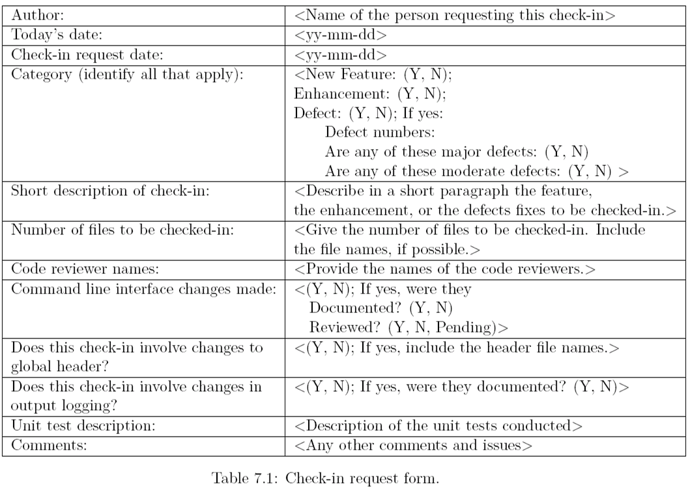
Check-in Request Form
Notes:
Handouts

Slide 27
Incremental
A software image is a compiled software binary
A build is an interim software image for internal testing within an organization
Constructing a build is a process by which individual modules are integrated to form am interim software image.
The final build is a candidate for system testing
Constructing a software image involves the following activities
  Gathering the latest unit tested, authorized versions of modules
  Compiling the source code of those modules
  Checking in the compiled code to the repository
  Linking the compiled modules into subassemblies
  Verifying that the subassemblies are correct
  Exercising version control
Notes:
Handouts

Slide 28
Incremental
Integration testing is conducted in an incremental manner as a series of test cycles
In each test cycle, a few more modules are integrated with an existing and tested build to generated larger builds
The complete system is built, cycle by cycle until the whole system is operational for system-level testing.
The number of SIT cycles and the total integration time are determined by the following parameters:
  Number of modules in the system
  Relative complexity of the module (cyclomatic complexity)
  Relative complexity of the interfaces between the modules
  Number of modules needed to be clustered together in each test cycle
  Whether the modules to be integrated have boon adequately tested before
  Turnaround time for each test-debug-fix cycle
Notes:
Handouts

Slide 29
Incremental
A release note containing the following information accompanies a build.
  What has changed since the last build?
  What outstanding defects have been fixed?
  What are the outstanding defects in the build?
  What new modules, or features, have been added?
  What existing modules, or features, have been enhanced, modified, or deleted?
  Are there any areas where unknown changes may have occurred?
A test strategy is created for each new build and the following issues are addressed while planning a test strategy
  What test cases need to be selected from the SIT test plan?
  What previously failed test cases should now be re-executed in order to test the fixes in the new build?
  How to determine the scope of a partial regression tests?
  What are the estimated time, resource deman, and cost to test this build?
Notes:
Handouts

Slide 30
Incremental
Creating a daily build is very popular among many organization
It facilitates to a faster delivery of the system
It puts emphasis on small incremental testing
It steadily increases number of test cases
The system is tested using automated, re-usable test cases
An effort is made to fix the defects that were found within 24 hours
Prior version of the build are retained for references and rollback
A typical practice is to retain the past 7-10 builds
Notes:
Handouts

Slide 31
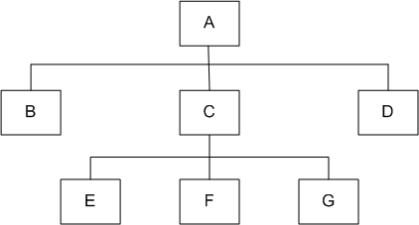
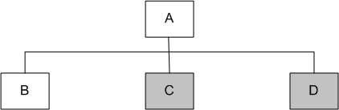
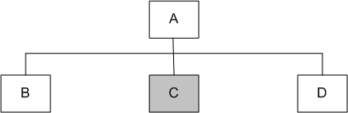
Top-down
Module A has been decomposed into modules B, C, and D
Modules B, D, E, F, and G are terminal modules
First integrate modules A and B using stubs C` and D` (represented by grey boxes)
Next stub D` has been replaced with its actual instance D
Two kinds of tests are performed:
  Test the interface between A and D
  Regression tests to look for interface defects between A and B in the presence of module D
Figure 7.1: A module hierarchy with three levels and seven modules
Figure 7.2: Top-down integration of modules A and B
Figure 7.3: Top-down integration of modules A, B and D
Notes:
Handouts

Slide 32
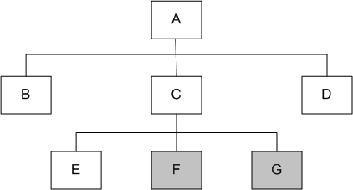
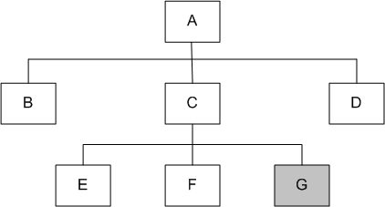
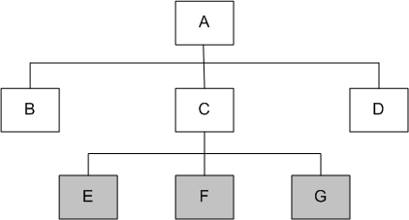
Top-down
Stub C` has been replaced with the actual module C, and new stubs E`, F`, and G`
Perform tests as follows:
  first, test the interface between A and C;
  second, test the combined modules A, B, and D in the presence of C
The rest of the process depicted in the right hand side figures.
Figure 7.5: Top-down integration of modules A, B, C, D and E
Figure 7.6: Top-down integration of modules A, B, C, D, E and F
Figure 7.4: Top-down integration of modules A, B, D and C
Notes:
Handouts

Slide 33
Top-down
Advantages
The SIT engineers continually observe system-level functions as the integration process continue
Isolation of interface errors becomes easier because of the incremental nature of the top-down integration
Test cases designed to test the integration of a module M are reused during the regression tests performed after integrating other modules
Disadvantages
It may not be possible to observe meaningful system functions because of an absence of lower level modules and the presence of stubs.
Test case selection and stub design become increasingly difficult when stubs lie far away from the top-level module.
Notes:
Handouts

Slide 34
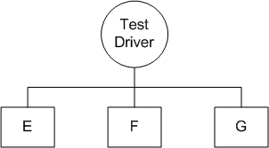
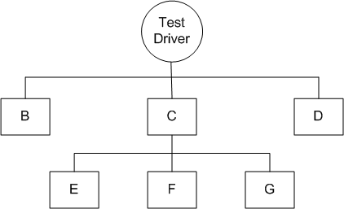
Bottom-up
We design a test driver to integrate lowest-level modules E, F, and G
Return values generated by one module is likely to be used in another module
The test driver mimics module C to integrate E, F, and G in a limited way.
The test driver is replaced with actual module , i.e., C.
A new test driver is used
At this moment, more modules such as B and D are integrated
The new test driver mimics the behavior of module A
Finally, the test driver is replaced with module A and further test are performed
Figure 7.8: Bottom-up integration of module E, F, and G
Figure 7.9: Bottom-up integration of module B, C, and D with F, F, and G
Notes:
Handouts

Slide 35
Bottom-up
Advantages
One designs the behavior of a test driver by simplifying the behavior of the actual module
If the low-level modules and their combined functions are often invoked by other modules, then it is more useful to test them first so that meaningful effective integration of other modules can be done
Disadvantages
Discovery of major faults are detected towards the end of the integration process, because major design decision are embodied in the top-level modules
Test engineers can not observe system-level functions from a partly integrated system. In fact, they can not observe system-level functions until the top-level test driver is in place
Notes:
Handouts

Slide 36
Big-bang and Sandwich
Big-bang Approach
First all the modules are individually tested
Next all those modules are put together to construct the entire system which is tested as a whole
Sandwich Approach
In this approach a system is integrated using a mix of top-down, bottom-up, and big-bang approaches
A hierarchical system is viewed as consisting of three layers
The bottom-up approach is applied to integrate the modules in the bottom-layer
The top layer modules are integrated by using top-down approach
The middle layer is integrated by using the big-bang approach after the top and the bottom layers have been integrated
Notes:
Handouts

